Slide 1
Berth
A Simple Chat Bot

Slide 2
Berth
Using Web Speech Api’s SpeechRecognition interface which listens to your voice via microphone.
Sends your message to Dialogflow(it is a natural language processing platform) as a text string.
As soon as the Dialogflow returns the reply text back, use the SpeechSynthesis interface to give it a synthetic voice.

Slide 3
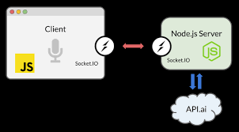
Architecture

Slide 4
Demo

